Slide 1
Employee Record Management System (ERMS)
Mini Project Presented by: Abarna Ragsitha
Reg no: 811324243003 Department: B.tech Artificial Intelligence and Data Science

Slide 2
Introduction
• Python-based employee management application • Maintains employee records • Performs payroll calculations • Demonstrates Object-Oriented Programming concepts

Slide 3
Objectives
• Manage employee records efficiently • Implement OOP concepts • Validate employee information • Generate payroll and Displays high paid employee.

Slide 4
Tech Stack
• Programming Language: Python • IDE: Visual Studio Code • Concepts used: Object-Oriented Programmingn concepts (Abstraction ,Encapsulation , Polymorphism , Inheritance)

Slide 5
OOP Concepts
Abstraction: Abstract Employee class Encapsulation: Private salary , employee ID and mailId. Inheritance: Employee Record inherits Employee Polymorphism: Overridden display() and salary calculation

Slide 6
Modules
• Employee Management • Payroll Management • Validation Module • Highest Paid Employee

Slide 7
Project Structure
employee.py employee_record.py erm.py payroll.py validation.py main.py

Slide 8
Features
• Add, View, Update, Delete Employee • Search Employee • Payroll Calculation • Phone No Validation • Highest Paid Employee

Slide 9
Workflow
Menu → Employee Operations → Validation → PayrollManagement→ Exit

Slide 10
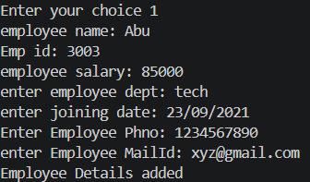
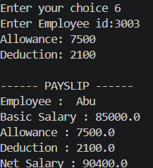


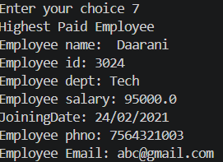
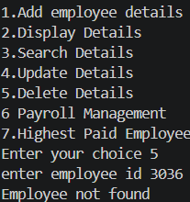

Slide 11
Conclusion
The project successfully demonstrates Python OOP concepts while providing an efficient employee management solution.

Slide 12
THANK YOU

